Slide 1
RUSTikales Rust for beginners

Slide 2
Plan for today

Slide 3
Plan for today
Recap

Slide 4
Plan for today
Recap
Functions

Slide 5
Plan for today
Recap
Functions
Floating Point Numbers

Slide 6
Recap

Slide 7
Recap
loop {} to create an infinite loop
while condition {} to create a conditional loop
for elem in collection {} to create an iterator over a collection

Slide 8
Recap
loop {} to create an infinite loop
while condition {} to create a conditional loop
for elem in collection {} to create an iterator over a collection
Ownership-Model
  Every value in Rust has exactly one owner
  Values are dropped (memory is freed) when the owner is dropped
  Ownership-Conflicts are resolved by moving ownership, if we can‘t copy the value

Slide 9
Recap
loop {} to create an infinite loop
while condition {} to create a conditional loop
for elem in collection {} to create an iterator over a collection
Ownership-Model
References
  Way to borrow data without moving or copying it
  Can be immutable or mutable

Slide 10
Recap
loop {} to create an infinite loop
while condition {} to create a conditional loop
for elem in collection {} to create an iterator over a collection
Ownership-Model
References
Borrow Checker
  zero mutable references to a value → infinite immutable references allowed
  one mutable reference to a value → zero immutable references allowed
  two+ mutable references to a value → forbidden, compiler error

Slide 11
Recap
loop {} to create an infinite loop
while condition {} to create a conditional loop
for elem in collection {} to create an iterator over a collection
Ownership-Model
References
Borrow Checker
Lifetimes
  Every reference has a lifetime
  Reference must be valid between creation and usage
  Value it points to must be alive
  Used by the Borrow Checker

Slide 12
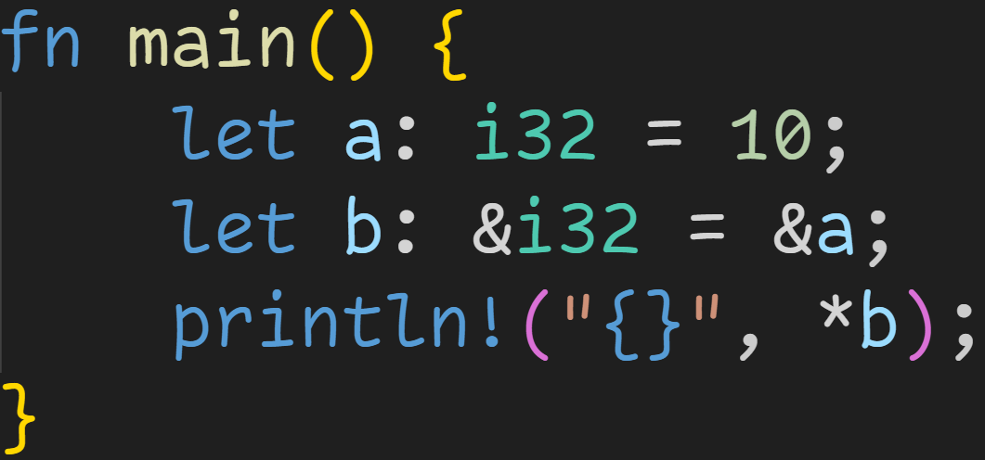
Recap

Slide 13
Recap
Immutable borrow

Slide 14
Recap
Type: Reference to i32

Slide 15
Recap
Dereference b to get the original value

Slide 16
Recap
Addr | Stack

Slide 17
Recap
Addr | Stack
0x4000 | a | 10

Slide 18
Recap
Addr | Stack
0x4000 | a | 10
0x4004 | b | 0x4000

Slide 19
Recap
Addr | Stack
0x4000 | a | 10
0x4004 | b | 0x4000
Read the value at that memory location

Slide 20

Recap
Addr | Stack
0x4000 | a | 10
0x4004 | b | 0x4000

Slide 21
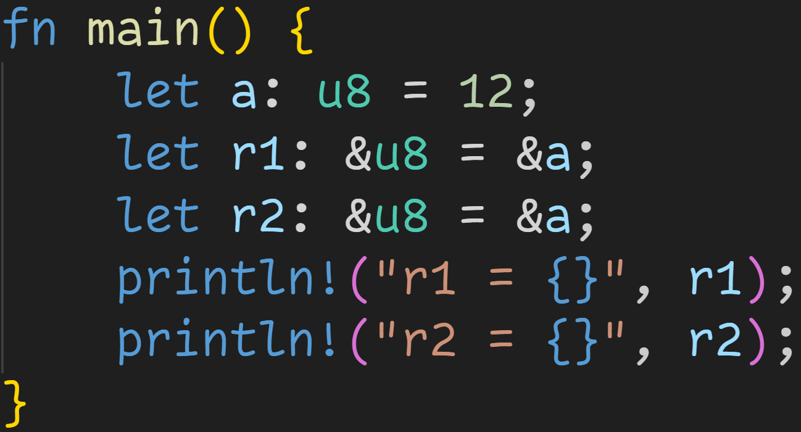
Recap

Slide 22
Recap
Immutable borrows

Slide 23
Recap
Implicit dereference

Slide 24
Recap
Addr | Stack

Slide 25
Recap
Addr | Stack
0x1000 | a | 12

Slide 26
Recap
Addr | Stack
0x1000 | a | 12
0x1001 | r1 | 0x1000

Slide 27
Recap
Addr | Stack
0x1000 | a | 12
0x1001 | r1 | 0x1000
0x1009 | r2 | 0x1000

Slide 28
Recap
Addr | Stack
0x1000 | a | 12
0x1001 | r1 | 0x1000
0x1009 | r2 | 0x1000
println! automatically dereferences for us

Slide 29
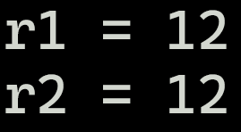
Recap
Addr | Stack
0x1000 | a | 12
0x1001 | r1 | 0x1000
0x1009 | r2 | 0x1000
println! automatically dereferences for us

Slide 30
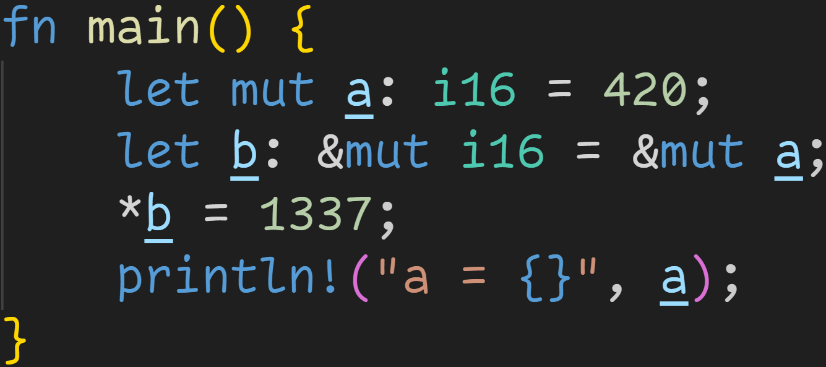
Recap

Slide 31
Recap
Mutable borrow

Slide 32
Recap
Mutable borrow only possible when value itself is mutable
Mutable borrow

Slide 33
Recap
Addr | Stack

Slide 34
Recap
Addr | Stack
0x8000 | a | 420

Slide 35
Recap
Addr | Stack
0x8000 | a | 420
0x8002 | b | 0x8000

Slide 36
Recap
Addr | Stack
0x8000 | a | 420
0x8002 | b | 0x8000
Write 1337 into location pointed to by b

Slide 37
Recap
Addr | Stack
0x8000 | a | 420
0x8002 | b | 0x8000
Write 1337 into location pointed to by b

Slide 38
Recap
Addr | Stack
0x8000 | a | 1337
0x8002 | b | 0x8000
Write 1337 into location pointed to by b

Slide 39

Recap
Addr | Stack
0x8000 | a | 1337
0x8002 | b | 0x8000

Slide 40
Functions

Slide 41
Functions
Programming languages come with many control flow abstractions

Slide 42
Functions
Programming languages come with many control flow abstractions
  if
  loops, break, continue

Slide 43
Functions
Programming languages come with many control flow abstractions
Functions are another way of controlling your code

Slide 44
Functions
Programming languages come with many control flow abstractions
Functions are another way of controlling your code
Functions allow us to isolate pieces of logic, instead of writing one big blob of code

Slide 45
Functions
Programming languages come with many control flow abstractions
Functions are another way of controlling your code
Functions allow us to isolate pieces of logic, instead of writing one big blob of code
  We can write a function that calculates prime numbers
  We can write a function that checks if a vector contains a given number
  We can write a function that checks if a vector only contains prime numbers

Slide 46
Functions
Programming languages come with many control flow abstractions
Functions are another way of controlling your code
Functions allow us to isolate pieces of logic, instead of writing one big blob of code
Functions in programming are almost* identical to mathematical functions
  They take in some inputs
  They do something with those inputs
  They return some output
  In programming, functions can have side effects
    Writing to a file, printing to the console, ...

Slide 47
Functions
Programming languages come with many control flow abstractions
Functions are another way of controlling your code
Functions allow us to isolate pieces of logic, instead of writing one big blob of code
Functions in programming are almost* identical to mathematical functions
Functions are declared using the keyword fn
  The most important one – fn main() – always needs to be declared

Slide 48
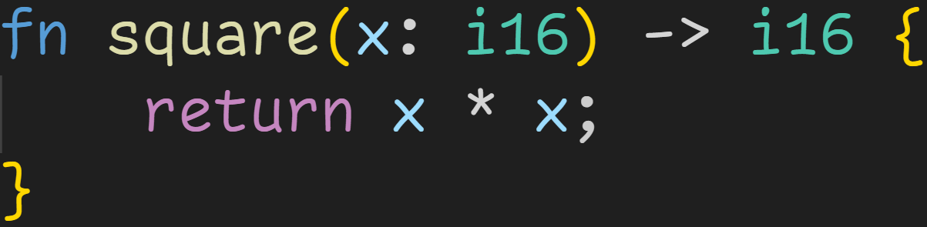
Functions

Slide 49
Functions
Parameters

Slide 50
Functions
Parameters
Return Type (optional)

Slide 51
Functions
Parameters
Return Type (optional)
Function body

Slide 52
Functions
Parameters
Return Type (optional)
return keyword
→ we return the provided value (here x * x) from the function

Slide 53
Functions
Function name
Parameters
Return Type (optional)
return keyword
→ we return the provided value (here x * x) from the function

Slide 54
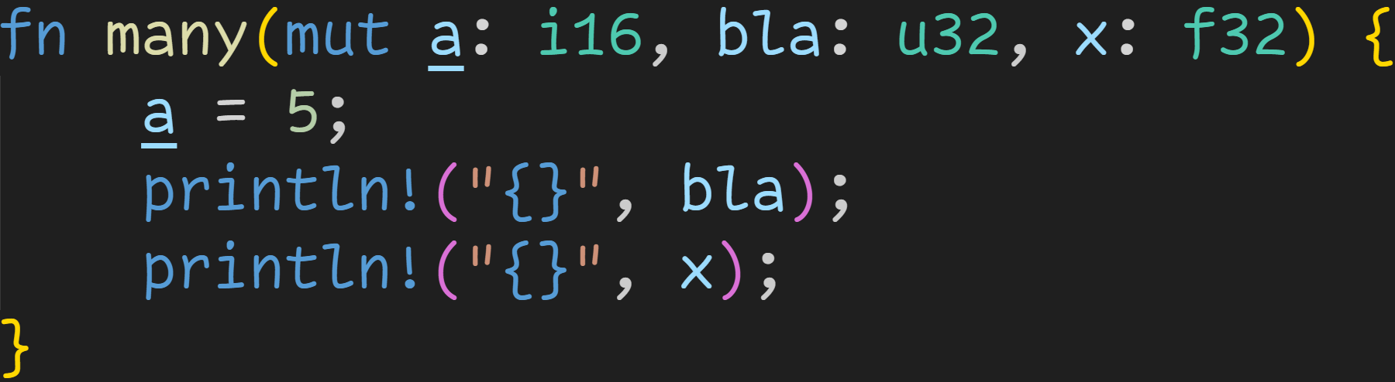
Functions

Slide 55
Functions
Parameters are comma-separated name-type pairs

Slide 56
Functions
Parameters are treated like normal variables:
→ Mutability rules apply
→ Ownership rules apply
→ Borrow Checker rules apply

Slide 57
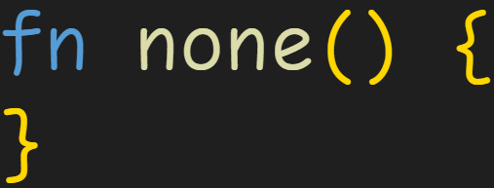
Functions
Functions can also take zero parameters

Slide 58
Functions
Not all functions return values, some just do stuff with the inputs
  It might just write to a file, or print something in the console

Slide 59
Functions
Not all functions return values, some just do stuff with the inputs
  It might just write to a file, or print something in the console
The return type is optional, and declared using the Arrow syntax

Slide 60
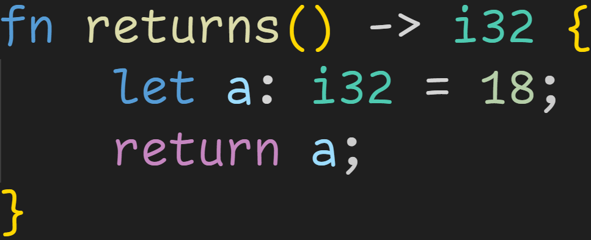
Functions
The return type is optional, and declared using the Arrow syntax

Slide 61
Functions
The return type is optional, and declared using the Arrow syntax
Arrow Syntax

Slide 62
Functions
The return type is optional, and declared using the Arrow syntax
This function returns a value of type i32

Slide 63
Functions
The return type is optional, and declared using the Arrow syntax
All return statements must return a value of the specified type

Slide 64
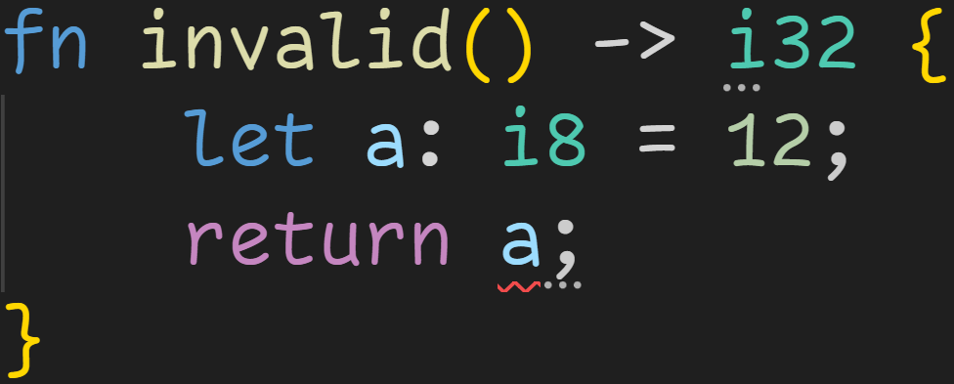
Functions

Slide 65
Functions
returns a value of type i8
→ i8 is not i32
→ Compiler error

Slide 66
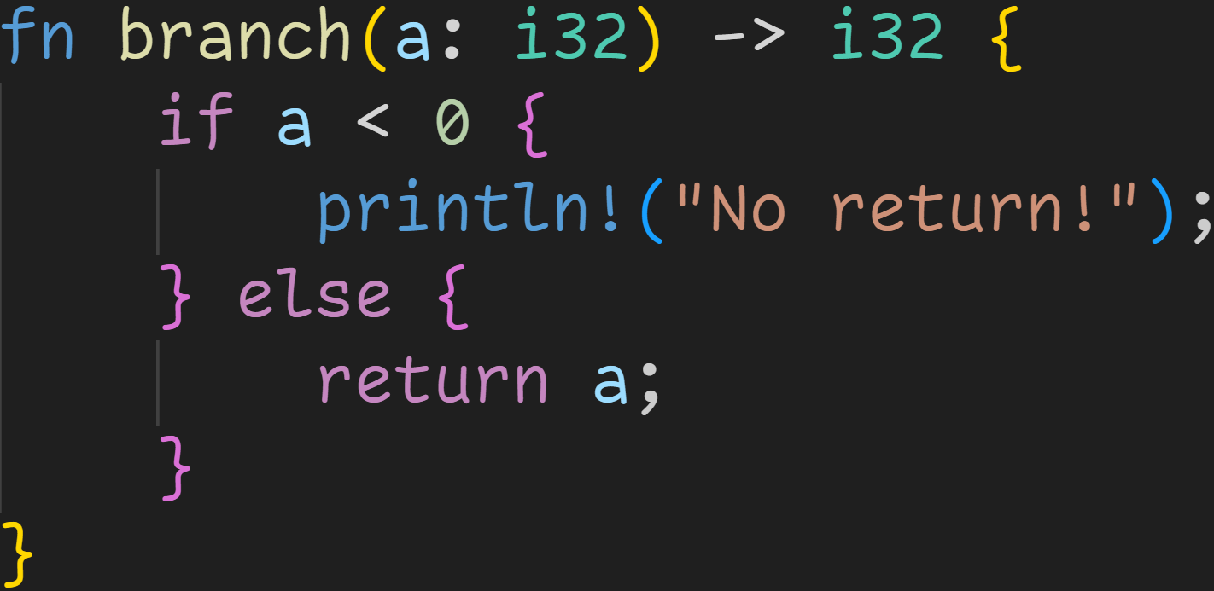
Functions

Slide 67
Functions
If a function is declared to return something, every possible control flow path must end with a return statement

Slide 68
Functions
This branch does not return a value, not even after the if-block
If a function is declared to return something, every possible control flow path must end with a return statement

Slide 69
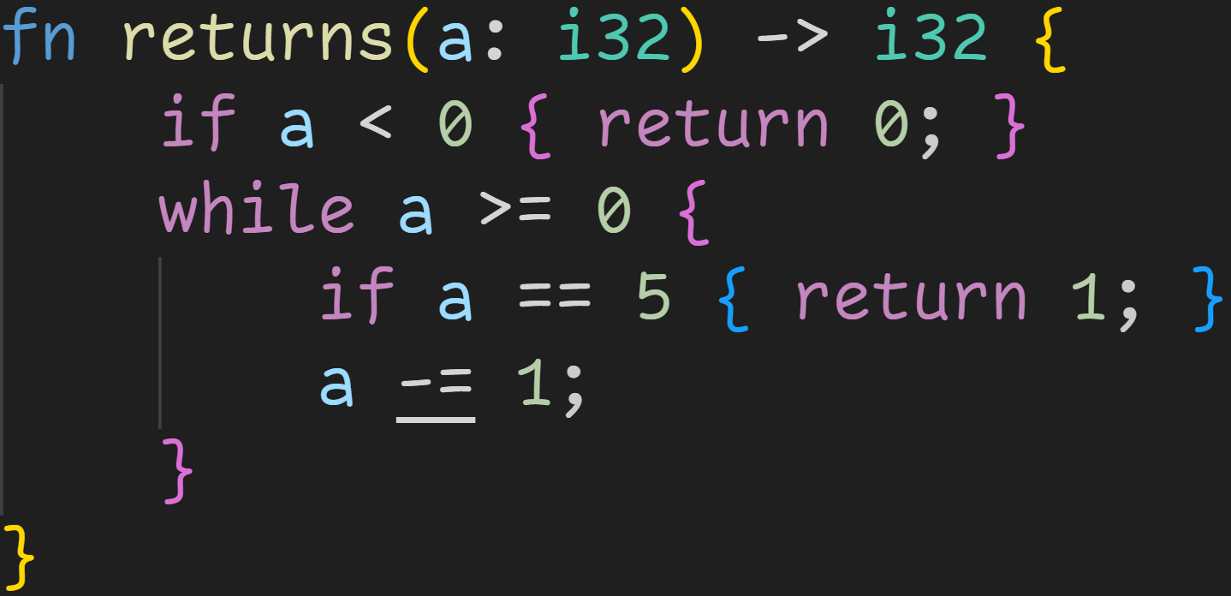
Functions
1/3

Slide 70
Functions
1/3
Do all possible paths lead to a return?

Slide 71
Functions
1/3
Do all possible paths lead to a return?
Nope. Imagine a was 4 in the beginning :^)
We get to the end of the function, but there is no return statement there!

Slide 72
Functions
1/3
Code wouldn‘t compile anyway, a is not mutable :^)

Slide 73
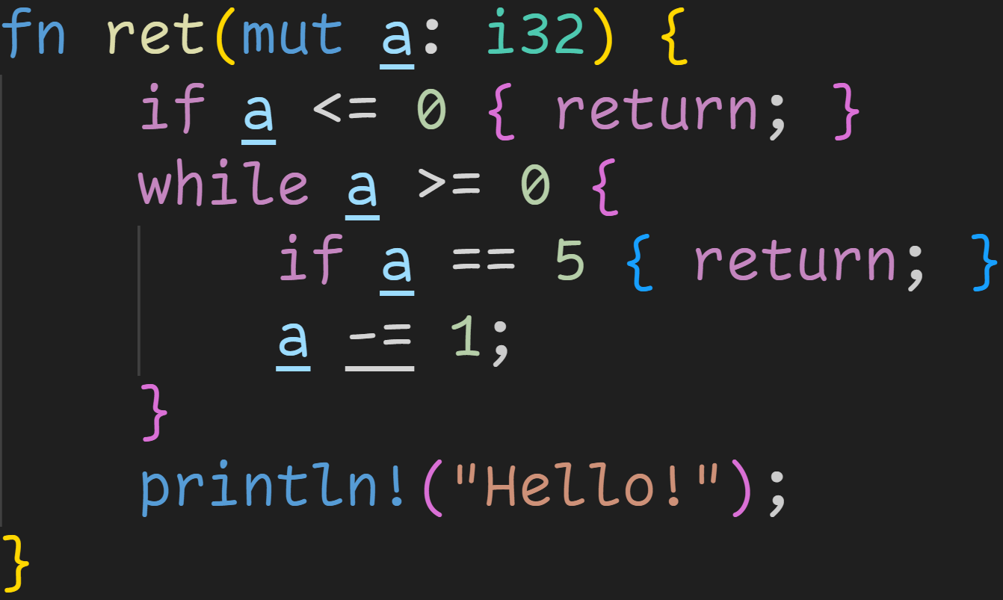
Functions

Slide 74
Functions
We don‘t return anything

Slide 75
Functions
Now we simply return – without a value

Slide 76
Functions
There‘s an implicit return at the end of every function, not every control flow path needs to end in a return

Slide 77
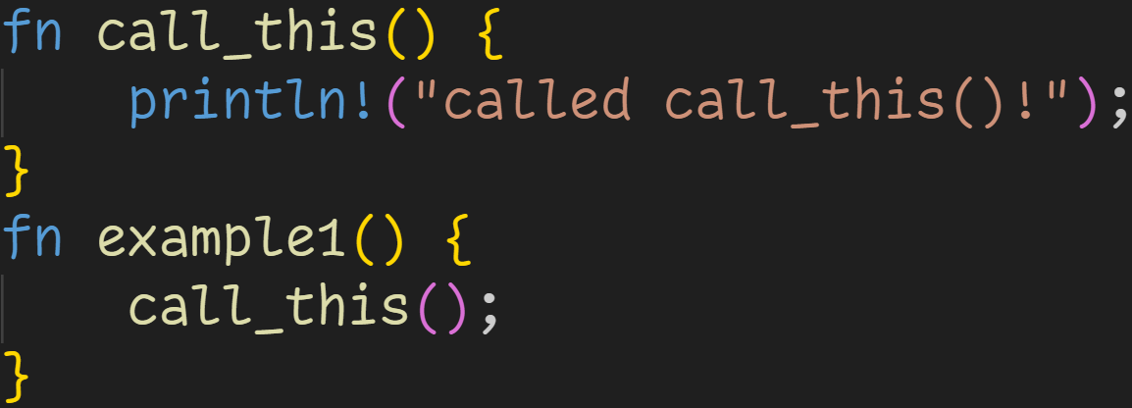
Functions

Slide 78
Functions
Function declaration

Slide 79
Functions
Function declaration
Function call

Slide 80
Functions
For every parameter, we have to provide an argument
→ call_this has no parameters, so we can call it as is

Slide 81
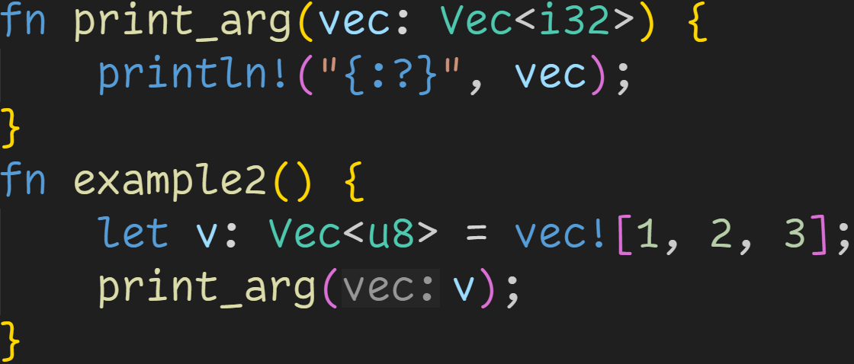
Functions

Slide 82
Functions
Every argument has to have the same type as the matching parameter

Slide 83
Functions
Type doesn‘t match → Compiler error
Every argument has to have the same type as the matching parameter

Slide 84
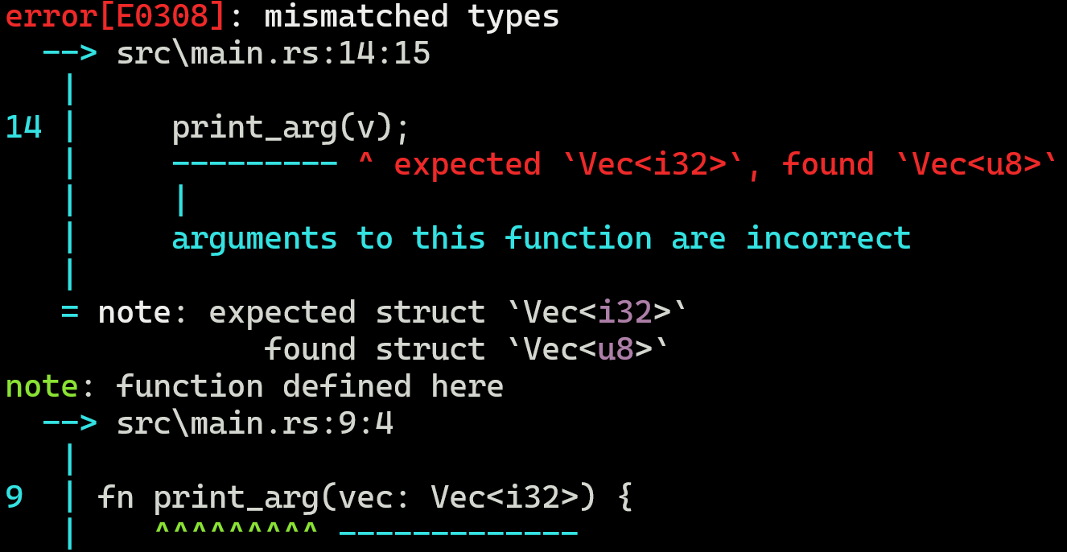

Functions

Slide 85
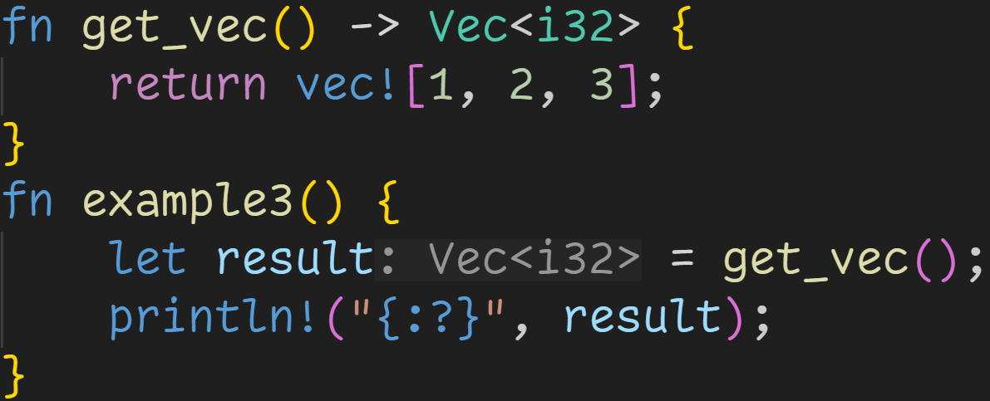
Functions

Slide 86
Functions
Return value can be used here

Slide 87

Functions
result in example3 has this value after the function call

Slide 88
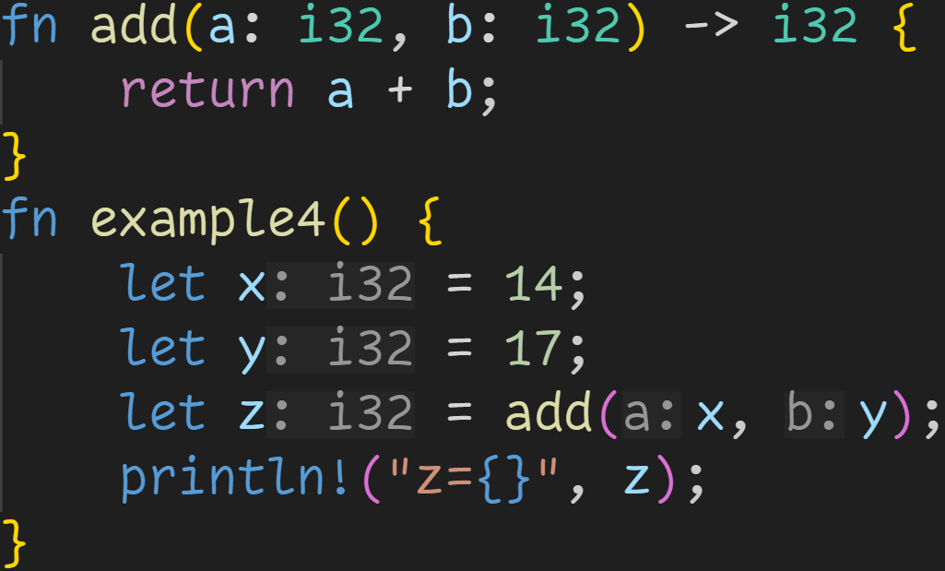
Functions

Slide 89
Functions
Function declared to take 2 parameters

Slide 90
Functions
Function declared to take 2 parameters
→ Function takes 2 arguments

Slide 91
Functions
Function declared to take 2 parameters
→ Function takes 2 arguments
Function declared to return i32

Slide 92
Functions
Function declared to take 2 parameters
→ Function takes 2 arguments
Function declared to return i32
→ add(x, y) evaluates to an i32

Slide 93
Functions
Function declared to take 2 parameters
→ Function takes 2 arguments
Function declared to return i32
→ add(x, y) evaluates to an i32
→ z is of type i32

Slide 94

Functions
Function declared to take 2 parameters
→ Function takes 2 arguments
Function declared to return i32
→ add(x, y) evaluates to an i32
→ z is of type i32
Code compiles, and prints 31

Slide 95
Intermission – Control Flow, again
But how does this work?
How does a know the value of x?
How does b know the value of y?
How does z know the return value?

Slide 96
Intermission – Control Flow, again
To understand this, we need to revisit memory and control flow

Slide 97
Intermission – Control Flow, again
To understand this, we need to revisit memory and control flow
→ Instructions are stored in memory

Slide 98
Intermission – Control Flow, again
To understand this, we need to revisit memory and control flow
→ Instructions are stored in memory
→ Whenever we call a function, the computer jumps there and executes that code

Slide 99
Intermission – Control Flow, again
To understand this, we need to revisit memory and control flow
→ Instructions are stored in memory
→ Whenever we call a function, the computer jumps there and executes that code
→ Variables and parameters are stored on the stack (usually)

Slide 100
Intermission – Control Flow, again
To understand this, we need to revisit memory and control flow
→ Instructions are stored in memory
→ Whenever we call a function, the computer jumps there and executes that code
→ Variables and parameters are stored on the stack (usually)
→ Every function allocates its own stack region, and frees it when you leave

Slide 101
Intermission – Control Flow, again
Stack

Slide 102
Intermission – Control Flow, again
Stack
x | ???
y | ???
z | ???

Slide 103
Intermission – Control Flow, again
Stack
x | 14
y | ???
z | ???

Slide 104
Intermission – Control Flow, again
Stack
x | 14
y | 17
z | ???

Slide 105
Intermission – Control Flow, again
Stack
x | 14
y | 17
z | ???
We want to jump to add, but we need to pass the arguments.
But we can‘t assign to a and b yet, they don‘t exist in memory!

Slide 106
Intermission – Control Flow, again
Stack
x | 14
y | 17
z | ???
We want to jump to add, but we need to pass the arguments.
But we can‘t assign to a and b yet, they don‘t exist in memory!
Solution: Our computer has registers
Register 1 | ???
Register 2 | ???

Slide 107
Intermission – Control Flow, again
Stack
x | 14
y | 17
z | ???
We want to jump to add, but we need to pass the arguments.
But we can‘t assign to a and b yet, they don‘t exist in memory!
Solution: Our computer has registers
Register 1 | 14
Register 2 | ???

Slide 108
Intermission – Control Flow, again
Stack
x | 14
y | 17
z | ???
We want to jump to add, but we need to pass the arguments.
But we can‘t assign to a and b yet, they don‘t exist in memory!
Solution: Our computer has registers
Register 1 | 14
Register 2 | 17

Slide 109
Intermission – Control Flow, again
Stack
x | 14
y | 17
z | ???
We can now call the function
Register 1 | 14
Register 2 | 17

Slide 110
Intermission – Control Flow, again
Stack
x | 14
y | 17
z | ???
a | ???
b | ???
Register 1 | 14
Register 2 | 17

Slide 111
Intermission – Control Flow, again
Stack
x | 14
y | 17
z | ???
a | ???
b | ???
We can now move the arguments into the variables
Register 1 | 14
Register 2 | 17

Slide 112
Intermission – Control Flow, again
Stack
x | 14
y | 17
z | ???
a | 14
b | ???
We can now move the arguments into the variables
Register 1 | 14
Register 2 | 17

Slide 113
Intermission – Control Flow, again
Stack
x | 14
y | 17
z | ???
a | 14
b | 17
We can now move the arguments into the variables
Register 1 | 14
Register 2 | 17

Slide 114
Intermission – Control Flow, again
Stack
x | 14
y | 17
z | ???
a | 14
b | 17
We can now move the arguments into the variables
And execute the code in our function!
Register 1 | 14
Register 2 | 17

Slide 115
Intermission – Control Flow, again
Stack
x | 14
y | 17
z | ???
a | 14
b | 17
However, we don‘t know where we should store this result.
It may be z, it may be in a vector, we don‘t know!
Register 1 | 14
Register 2 | 17

Slide 116
Intermission – Control Flow, again
Stack
x | 14
y | 17
z | ???
a | 14
b | 17
However, we don‘t know where we should store this result.
It may be z, it may be in a vector, we don‘t know!
Solution: Store it in a register, and leave it to the caller
Register 1 | 31
Register 2 | 17

Slide 117
Intermission – Control Flow, again
Stack
x | 14
y | 17
z | ???
We return now, which means cleaning the stack
Register 1 | 31
Register 2 | 17

Slide 118
Intermission – Control Flow, again
Stack
x | 14
y | 17
z | ???
We now have the result in Register 1, which we can use
Register 1 | 31
Register 2 | 17

Slide 119
Intermission – Control Flow, again
Stack
x | 14
y | 17
z | 31
We now have the result in Register 1, which we can use
→ We move the value into z
Register 1 | 31
Register 2 | 17

Slide 120

Intermission – Control Flow, again
Stack
x | 14
y | 17
z | 31
Our program prints 31

Slide 121
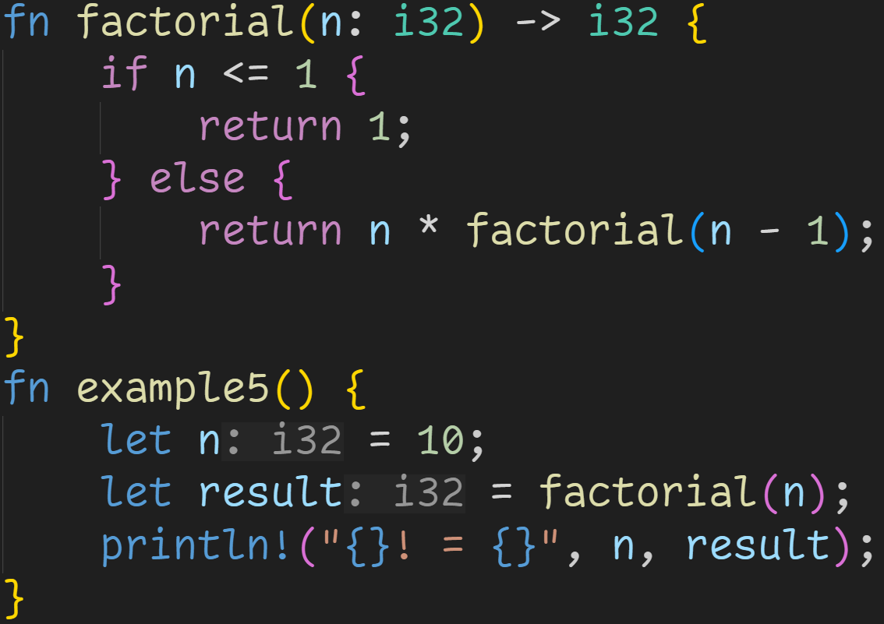
Functions

Slide 122
Functions
Function calls are expressions

Slide 123
Functions
Recursion: Calling a function in itself

Slide 124
Functions
Stack

Slide 125
Functions
Stack
n | ???
result | ???
Registers
Ret | ???
Arg | ???

Slide 126
Functions
Stack
n | 10
result | ???
Registers
Ret | ???
Arg | ???

Slide 127
Functions
Stack
n | 10
result | ???
Registers
Ret | ???
Arg | 10

Slide 128
Functions
Stack
n | 10
result | ???
n | 10
Registers
Ret | ???
Arg | 10

Slide 129
Functions
Stack
n | 10
result | ???
n | 10
Registers
Ret | ???
Arg | 10
false

Slide 130
Functions
Stack
n | 10
result | ???
n | 10
Registers
Ret | ???
Arg | 10
false
Need to evaluate this expression before we can return a value

Slide 131
Functions
Stack
n | 10
result | ???
n | 10
Registers
Ret | ???
Arg | 9
false

Slide 132
Functions
Stack
n | 10
result | ???
n | 10
n | 9
Registers
Ret | ???
Arg | 9

Slide 133
Functions
Stack
n | 10
result | ???
n | 10
n | 9
Registers
Ret | ???
Arg | 9
Every time we call a function, we allocate new stack space
→ Every n we see here is in a different memory location!
→ Every function can only directly access its own stack space

Slide 134
Functions
Stack
n | 10
result | ???
n | 10
n | 9
Registers
Ret | ???
Arg | 8
false

Slide 135
Functions
Stack
n | 10
result | ???
n | 10
n | 9
n | 8
Registers
Ret | ???
Arg | 8

Slide 136
Functions
Stack
n | 10
result | ???
n | 10
n | 9
n | 8
Registers
Ret | ???
Arg | 7
false

Slide 137
Functions
Stack
n | 10
result | ???
n | 10
n | 9
n | 8
n | 7
Registers
Ret | ???
Arg | 7

Slide 138
Functions
Stack
n | 10
result | ???
n | 10
n | 9
n | 8
n | 7
n | 6
n | 5
n | 4
n | 3
n | 2
n | 1
Registers
Ret | ???
Arg | 1
Much later...

Slide 139
Functions
Stack
n | 10
result | ???
n | 10
n | 9
n | 8
n | 7
n | 6
n | 5
n | 4
n | 3
n | 2
n | 1
Registers
Ret | ???
Arg | 1
This is where the name Stack Overflow comes from:
→ Every time we call a recursive function, we allocate more memory
→ Memory is limited, we can easily allocate too much

Slide 140
Functions
Stack
n | 10
result | ???
n | 10
n | 9
n | 8
n | 7
n | 6
n | 5
n | 4
n | 3
n | 2
n | 1
Registers
Ret | 1
Arg | 1
true

Slide 141
Functions
Stack
n | 10
result | ???
n | 10
n | 9
n | 8
n | 7
n | 6
n | 5
n | 4
n | 3
n | 2
Registers
Ret | 1
Arg | 1
The computer keeps track of called functions
→ We can now go up the call chain and compute the result

Slide 142
Functions
Stack
n | 10
result | ???
n | 10
n | 9
n | 8
n | 7
n | 6
n | 5
n | 4
n | 3
Registers
Ret | 2
Arg | 1
The computer keeps track of called functions
→ We can now go up the call chain and compute the result

Slide 143
Functions
Stack
n | 10
result | ???
n | 10
n | 9
n | 8
n | 7
n | 6
n | 5
n | 4
Registers
Ret | 6
Arg | 1
The computer keeps track of called functions
→ We can now go up the call chain and compute the result

Slide 144
Functions
Stack
n | 10
result | ???
n | 10
n | 9
n | 8
n | 7
n | 6
n | 5
Registers
Ret | 24
Arg | 1
The computer keeps track of called functions
→ We can now go up the call chain and compute the result

Slide 145
Functions
Stack
n | 10
result | ???
n | 10
Registers
Ret | 362880
Arg | 1
Much later...
The computer keeps track of called functions
→ We can now go up the call chain and compute the result

Slide 146
Functions
Stack
n | 10
result | ???
Registers
Ret | 3628800
Arg | 1
We have now computed the result, which is located in the return register

Slide 147
Functions
Stack
n | 10
result | 3628800
Registers
Ret | 3628800
Arg | 1

Slide 148

Functions
Stack
n | 10
result | 3628800
Registers
Ret | 3628800
Arg | 1

Slide 149
Floating Point Numbers

Slide 150
Floating Point Numbers
Integers are good, your computer loves them, but they have their limits

Slide 151
Floating Point Numbers
Integers are good, your computer loves them, but they have their limits
  We can only represent whole numbers
  We can‘t represent big numbers

Slide 152
Floating Point Numbers
Integers are good, your computer loves them, but they have their limits
For those situations, we have to use floating point numbers

Slide 153
Floating Point Numbers
Integers are good, your computer loves them, but they have their limits
For those situations, we have to use floating point numbers
Rust has f32 and f64

Slide 154
Floating Point Numbers
Integers are good, your computer loves them, but they have their limits
For those situations, we have to use floating point numbers
Rust has f32 and f64
As with integers, the number specifies the size in bits
  f32 → 32bit float
  f64 → 64bit float

Slide 155
Floating Point Numbers
Integers are good, your computer loves them, but they have their limits
For those situations, we have to use floating point numbers
Rust has f32 and f64
As with integers, the number specifies the size in bits
Floating Point numbers are numbers in Scientific Notation (in base 2)
  Example in base 10: 5e7 = 5*10^7 = 50.000.000

Slide 156
Floating Point Numbers
Integers are good, your computer loves them, but they have their limits
For those situations, we have to use floating point numbers
Rust has f32 and f64
As with integers, the number specifies the size in bits
Floating Point numbers are numbers in Scientific Notation (in base 2)
  Example in base 10: 5e7 = 5*10^7 = 50.000.000
  Numbers are stored in two parts:
    Mantissa → Number before the e, here 5
    Exponent → Number after the e, here 7

Slide 157
Floating Point Numbers
Floating Point numbers are numbers in Scientific Notation (in base 2)
  Example in base 10: 5e7 = 5*10^7 = 50.000.000
  Numbers are stored in two parts:
    Mantissa → Number before the e, here 5
    Exponent → Number after the e, here 7
Floats get a few bits for the mantissa, and a few for the exponent
  f32 → 1 bit sign, 8 bits exponent , 23 bits mantissa
  f64 → 1 bit sign, 11 bits exponent , 52 bits mantissa

Slide 158
Floating Point Numbers
Floating Point numbers are numbers in Scientific Notation (in base 2)
Floats get a few bits for the mantissa, and a few for the exponent
This way, we can represent fractions
  f32 → ~8 decimal digits
  f64 → ~16 decimal digits

Slide 159
Floating Point Numbers
Floating Point numbers are numbers in Scientific Notation (in base 2)
Floats get a few bits for the mantissa, and a few for the exponent
This way, we can represent fractions
  f32 → ~8 decimal digits
  f64 → ~16 decimal digits
This way, we can represent big numbers
  f32 → ~3.4*10^38 = 340...000 with 38 zeroes
    With integers, we would need a u128 to represent that
  f64 → ~1.8*10^308 = 180...000 with 308 zeroes
    With integers, we would need a u1024 to represent that

Slide 160
Floating Point Numbers
Floating Point numbers are numbers in Scientific Notation (in base 2)
Floats get a few bits for the mantissa, and a few for the exponent
This way, we can represent fractions
  f32 → ~8 decimal digits
  f64 → ~16 decimal digits
This way, we can represent big numbers
  f32 → ~3.4*10^38 = 340...000 with 38 zeroes
  f64 → ~1.8*10^308 = 180...000 with 308 zeroes
This way, we can represent small numbers
  f32 → ~3.4*10^-38 = 0.000...034 with 38 zeroes
  f64 → ~1.8*10^-308 = 0.000...018 with 308 zeroes

Slide 161
Floating Point Numbers
There‘s a problem → Limited precision

Slide 162
Floating Point Numbers
There‘s a problem → Limited precision
  We can only store 8 (f64: 16) decimal digits at all times in the mantissa
  → At big exponents, we skip numbers
  → 5.400000000*10^30 + 1 == 5.400000000*10^30

Slide 163
Floating Point Numbers
There‘s a problem → Limited precision
  We can only store 8 (f64: 16) decimal digits at all times in the mantissa
  → At big exponents, we skip numbers
  → 5.400000000*10^30 + 1 == 5.400000000*10^30
  We only have limited space for numbers
  → Just like we can‘t represent 1/3 in base 10, we can‘t represent some numbers in base 2

Slide 164
Floating Point Numbers
There‘s a problem → Limited precision
  We can only store 8 (f64: 16) decimal digits at all times in the mantissa
  → At big exponents, we skip numbers
  → 5.400000000*10^30 + 1 == 5.400000000*10^30
  We only have limited space for numbers
  → Just like we can‘t represent 1/3 in base 10, we can‘t represent some numbers in base 2
In practice, they are still extremely useful for applications where „good enough“ is fine
  For example, Computer Graphics or Physics Simulations
  Just don‘t manage your finances with them :^)

Slide 165
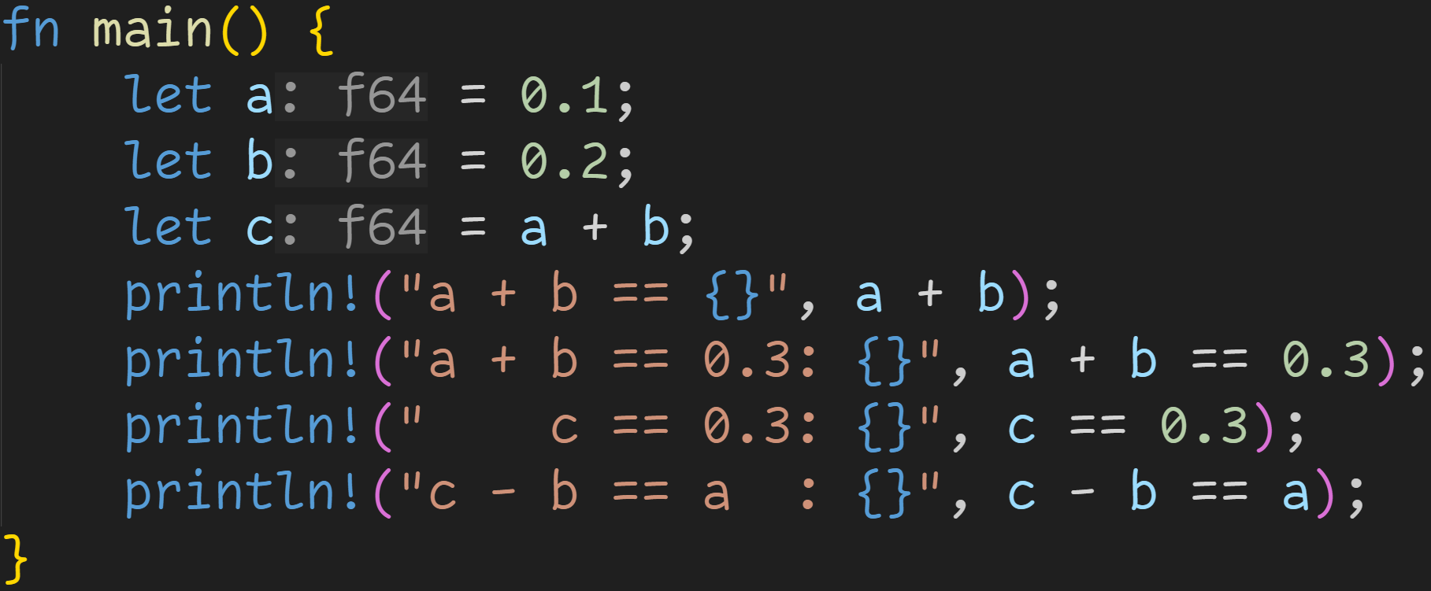
Floating Point Numbers

Slide 166
Floating Point Numbers
With Floating Point numbers, we can now use fractions

Slide 167
Floating Point Numbers
However, even simple operations may not behave the way you would expect

Slide 168
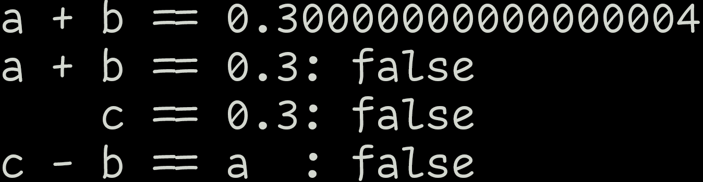
Floating Point Numbers

Slide 169
Floating Point Numbers
Floating Point can‘t represent every number, we have to deal with precision errors

Slide 170
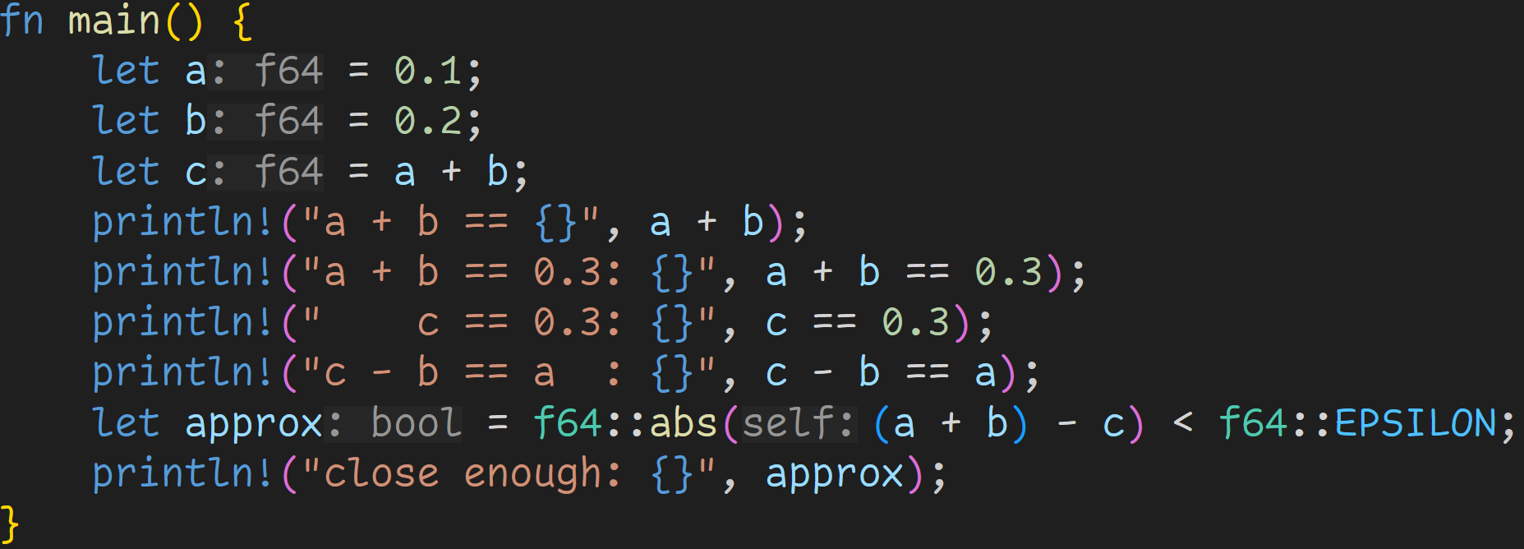
Floating Point Numbers

Slide 171
Floating Point Numbers
Always necessary to test for equality within a given tolerance
→ The numbers are close enough and effectively the same

Slide 172
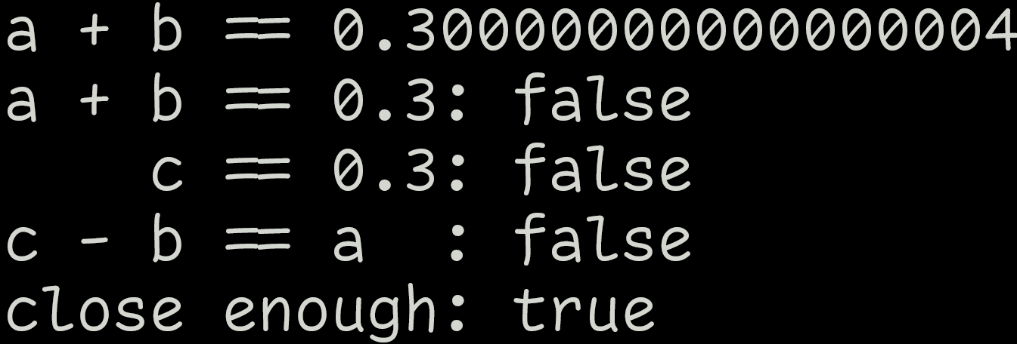
Floating Point Numbers

Slide 173
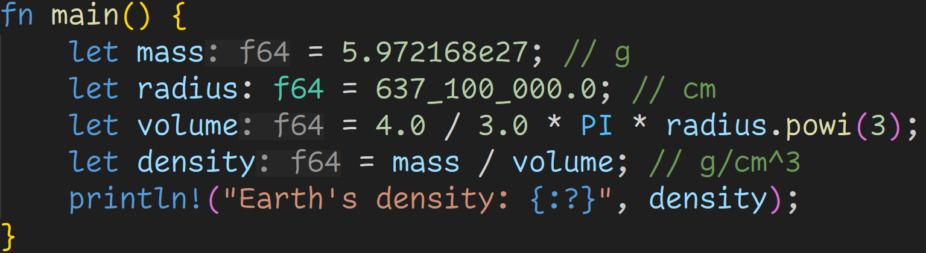
Floating Point Numbers

Slide 174
Floating Point Numbers
Float Literals can also be specified in scientific notation

Slide 175
Floating Point Numbers
The .0 is mandatory. Otherwise, Rust will treat this as an integer literal and print an error.

Slide 176
Floating Point Numbers

Slide 177
Floating Point Numbers
Even with precision errors, floats are still good enough for many applications
Here: A rounding error of 0.000000000001 doesn‘t influence the final result
But still, errors propagate! Calculation errors in a loop may add up over time.

Slide 178
Intermission - Exercises
Time for exercises!

Slide 179
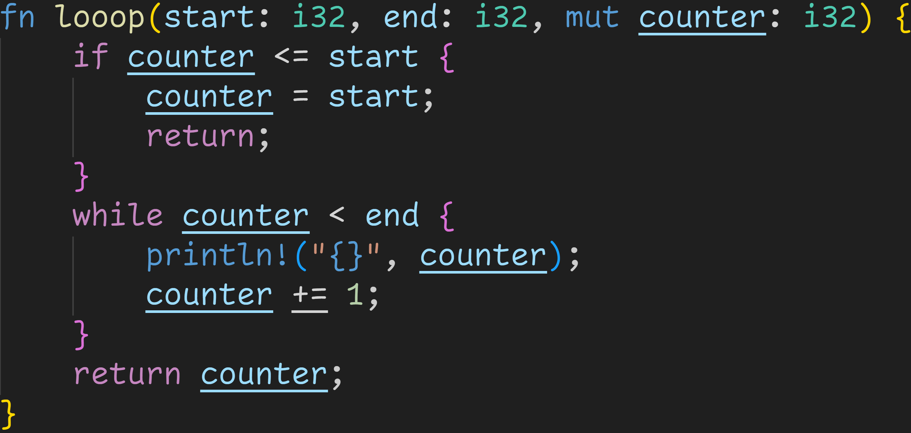
Intermission - Exercises
2/3

Slide 180
Intermission - Exercises
Is this a valid function definition?
2/3

Slide 181
Intermission - Exercises
Is this a valid function definition?
2/3
Function not declared to return anything

Slide 182
Intermission - Exercises
Is this a valid function definition?
2/3
Function not declared to return anything
Yet, we‘re attempting to return i32.
→ Not a valid function

Slide 183
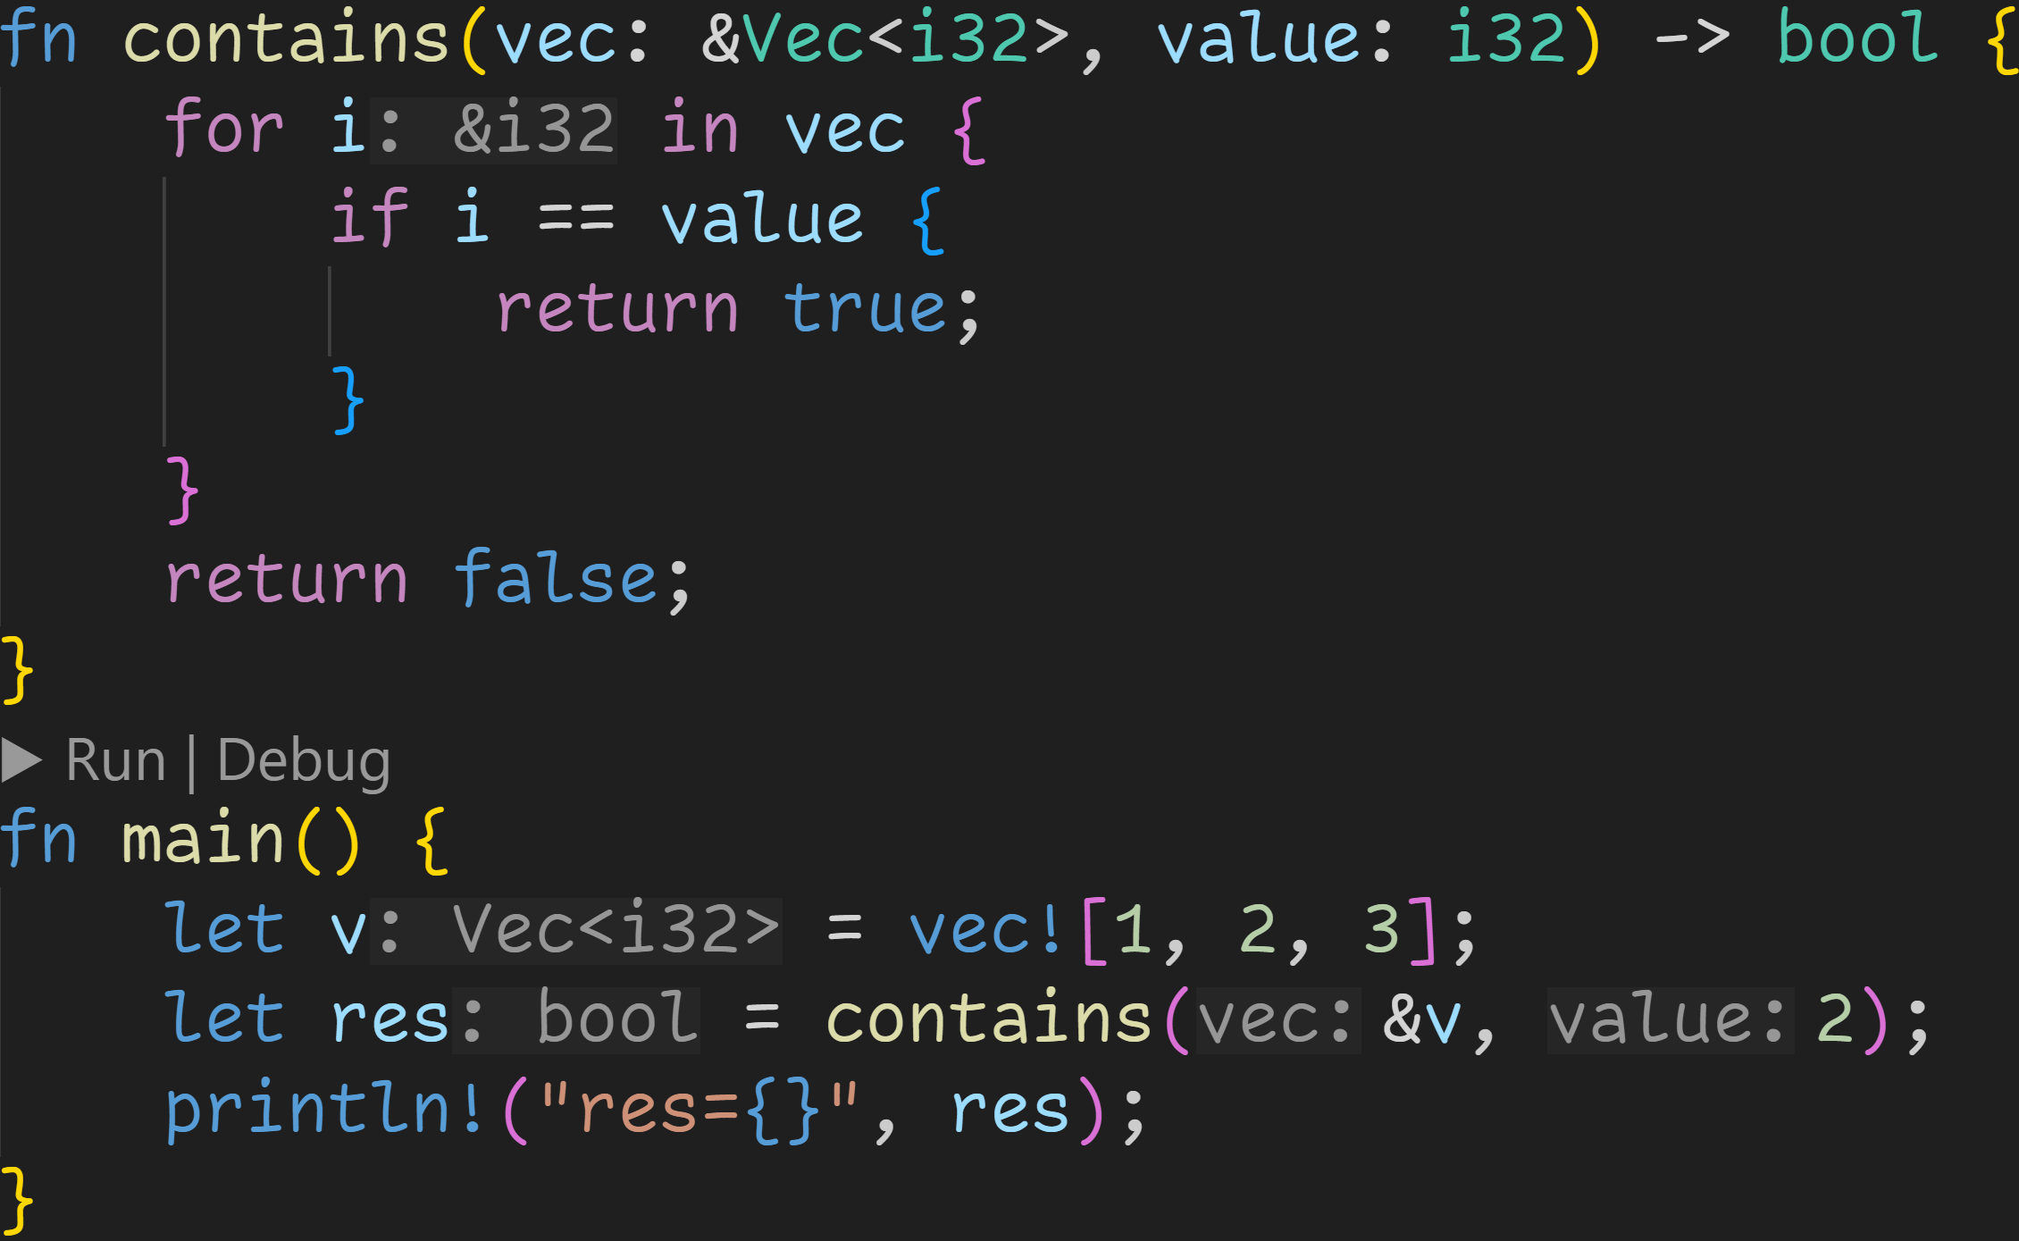
Intermission - Exercises
2/3

Slide 184
Intermission - Exercises
2/3
Does the code compile?
If yes, what does it print?

Slide 185
Intermission - Exercises
2/3
Does the code compile?
If yes, what does it print?
This code is almost perfect, there are no errors in the arguments or return values

Slide 186
Intermission - Exercises
2/3
Does the code compile?
If yes, what does it print?
BUT: &i32 == i32 is not defined :^)
The correct implementation would‘ve been *i == value
This code is almost perfect, there are no errors in the arguments or return values

Slide 187
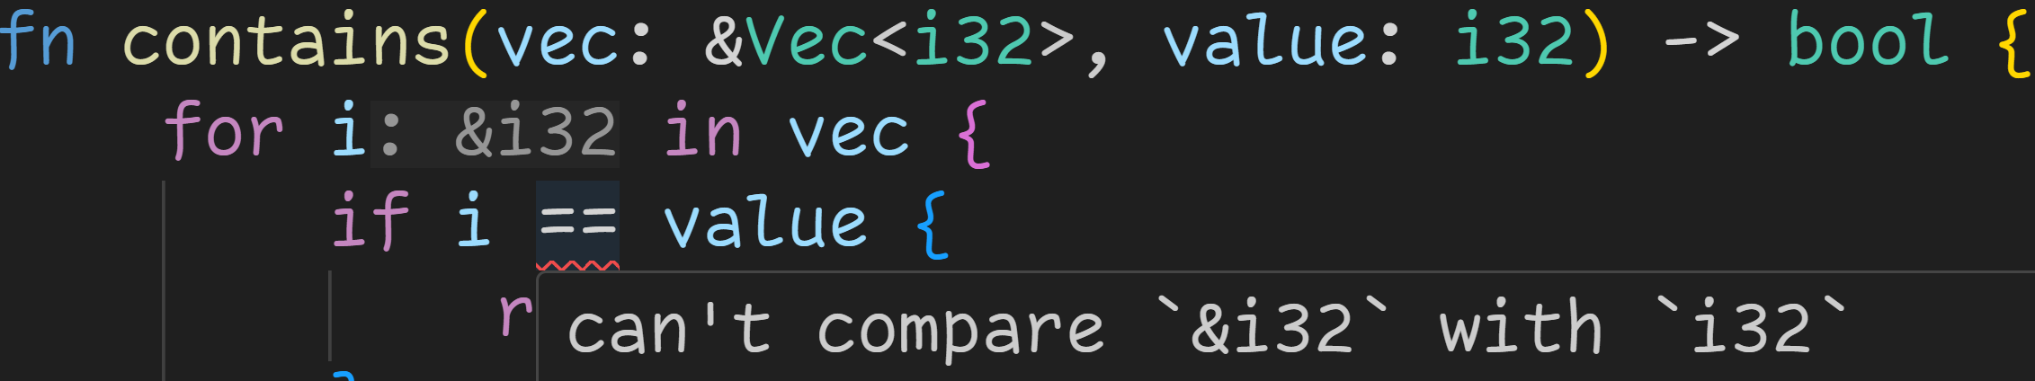
Intermission - Exercises
2/3
Does the code compile?
If yes, what does it print?

Slide 188
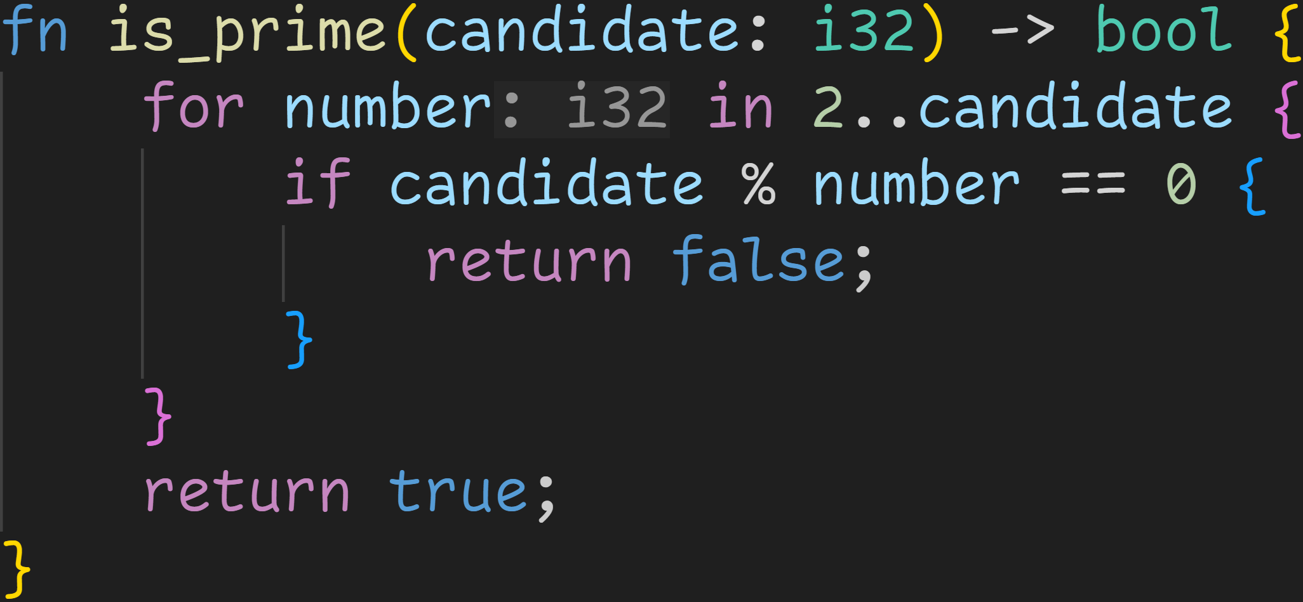
Intermission - Exercises
3/3

Slide 189
Intermission - Exercises
Is this function correct?
3/3

Slide 190
Intermission - Exercises
Is this function correct?
3/3
The algorithm itself is correct, it correctly tells us if a given number is prime or not.

Slide 191
Intermission - Exercises
Is this function correct?
3/3
The algorithm itself is correct, it correctly tells us if a given number is prime or not.
BUT: It returns true for negative numbers, 0 and 1! :^)
Those are not prime numbers :(

Slide 192
Intermission - Exercises
3/3
The algorithm itself is correct, it correctly tells us if a given number is prime or not.
BUT: It returns true for negative numbers, 0 and 1! :^)
Those are not prime numbers :(
How do we fix that?

Slide 193

Intermission - Exercises
Step 1: Prevent negative numbers!
3/3

Slide 194
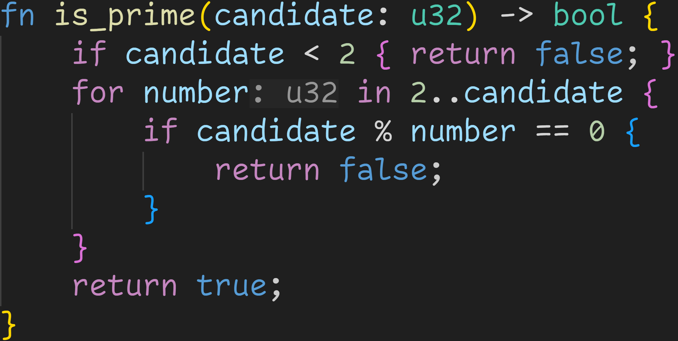
Intermission - Exercises
3/3
Step 2: 0 and 1 are not prime

Slide 195
Intermission - Exercises
3/3
Is this a correct function now?

Slide 196
Intermission - Exercises
3/3
Is this a correct function now?
Yes :)

Slide 197
Next time
Structs
Methods

